Slide 1
Stress Level Detection Based on Sleeping Habits Using Decision Tree Classifier
Maria Jacob
PG Scholar
Amal Jyothi College of Engineering
AJC19MCA-I037
National Conference on Emerging Computer Applications (NCECA)-2023

Slide 2
Table of Content
Abstract​
Literature Survey​
Introduction​
Methodology​
​Visualize the Stress Level
Implementation
Conclusion​
References ​

Slide 3
Abstract
In today's fast-paced world, understanding and predicting human stress levels is crucial for promoting mental well-being.
The modern lifestyle often neglects the importance of sleep, which offers numerous benefits to the human body.
The main objective of this study is to investigate how machine learning can be used to detect human stress levels based on sleep-related behaviors.
we employ machine learning techniques to assess and predict stress levels based on an individual's sleep patterns. By compiling a comprehensive dataset that includes sleep duration, quality, and relevant factors, we aim to establish correlations with stress.

Slide 4
This study includes the Decision Tree ML technique as a key component. It provides a clear and intelligible method for making decisions, which is helpful in comprehending the complex connections between stress and sleeping patterns. A structured model that is highly accurate in both classifying and predicting stress levels can be created using decision trees.
Our dataset, "Stress.csv," which includes pertinent physiological and sleep-related characteristics, was retrieved.
Snoring Rate, Respiration Rate, Body Temperature, Limb Movement, Blood Oxygen, Eye Movement, Sleeping Hours, Heart Rate, Stress Level are the features of this dataset.

Slide 5
Literature Survey
The idea of stress and how it affects people's health and wellbeing have been the subject of in-depth research over the years.
We examine the corpus of research on stress prediction and the function of machine learning algorithms in this overview of the literature.
This section presents an overview of seminal research in this domain, providing valuable insights into the evolution of predictive methodologies for detecting stress

Slide 6
Paper [1] “Stress Detection Using Machine Learning Algorithms” by V.R. Archana (August-2020) underscores the pervasive impact of stress on mental health, highlighting its recognition as a major concern by the World Health Organization.
To mitigate the effects of stress, the paper introduces a system that employs statistical data and machine learning algorithms, including Naïve-Bayes, and K-Nearest Neighbor, to accurately predict stress levels and enable proactive measures to address this significant issue.

Slide 7
Paper [2] “ Stress Prediction Based on Sleeping Habits Using Machine Learning Algorithms” by G. Jayawickrama, R.A.H.M. Rupasingha (2023) examines the vital function that stress plays in modern life and the importance of keeping an eye on stress levels for general health.
Using the Random Forest Classifier method, it presents a revolutionary system that can accurately predict stress levels by analyzing a variety of sleep-related factors.

Slide 8
Given the rising prevalence of stress-related issues among young people, this seminar paper [3] “Stress Detection Using Machine Learning Techniques” by R. Swarna Malika explores the importance of stress detection using machine learning techniques.
It demonstrates the use of random forest and logistic regression techniques to examine a stress dataset obtained from Kaggle, with random forest obtaining the best accuracy.
In light of real-time healthcare data, the conclusion recommends automating stress detection by sensor-based stress detection as well as additional advancements with k-fold cross-validation.

Slide 9
This seminar paper [4] “Stress Detection Based on Human Parameters Using Machine Learning Algorithms” by ] S.Kaviyab , S.Sarika combines a variety of machine learning methods, including Random Forest Classifier, Decision Tree, Naive Bayes, Support Vector Machine, and K-Nearest Neighbor, to detect stress based on human factors.
The study seeks to identify potential health issues as well as the presence of stress by assessing a set of factors.
The study highlights the potential for improving health monitoring and diagnosis by outlining future plans for stress categorization utilizing deep learning algorithms and real-time EEG signals. It also reports an amazing 93.2% accuracy rate for stress detection.

Slide 10
This seminar paper [5] “sleepWell: Stress Level Prediction Through Sleep Data. Are You Stressed?” by Md Minhazur Rahman, ASM Mohaimenul Islam addresses the critical issue of stress detection, utilizing machine learning techniques to enhance the quality of daily life.
The study focuses on identifying stress levels in individuals during sleep using the SayoPillow dataset and offers various machine learning models.
Notably, the SVM and Gaussian Naive Bayes models demonstrate superior performance, showing promise for early stress detection and potential applications in healthcare and IoT.

Slide 11
Introduction
Stress is a mental or emotional condition arising from challenging or inescapable situations. It is a pressure exerted on the human body due to various stress-inducing factors.
The objective of this seminar paper is to explore a method for detecting stress levels using sleep patterns.
Decision Tree is chosen due to its interpretability and transparency. It allows visualization and understanding of the decision-making process for stress level prediction.
Machine learning and the Decision Tree method will be employed for this purpose. This seminar paper aims to provide insights into a reliable and impartial approach for evaluating stress levels by analyzing sleep patterns.

Slide 12
Methodology
Data collection, preprocessing, feature engineering, model selection, training, and evaluation are all included in the methodology.
Initially, we preprocess and explore the dataset, handling missing values and transforming features.

Slide 13
Data Collection
The foundation of our research lies in the quality and quantity of data collected. Our dataset, "Stress.csv," which includes pertinent physiological and sleep-related characteristics, was retrieved.
Snoring Rate, Respiration Rate, Body Temperature, Limb Movement, Blood Oxygen, Eye Movement, Sleeping Hours, Heart Rate are the features of this dataset.
The relevance of each item in the dataset was determined by its capacity to predict stress levels. The Pandas package was used to import the dataset, allowing for data manipulation and analysis.

Slide 14
Data Pre-processing
Even if raw data is large, it frequently has to be refined in order to reach its full potential.
To minimize any inherent difficulties, such as missing values, outliers, and inconsistencies, we carefully handled the dataset throughout this phase.
The process of preparing data included renaming columns to increase readability, conducting exploratory analysis of the data to determine the core properties of the data, and developing plans for dealing with missing data.
To further reveal underlying patterns and correlations in the dataset, sophisticated data visualization techniques were used.

Slide 15
Training and Evaluation
Machine Learning Model Selection
Choosing the right prediction model is a crucial step in our research process.
The DecisionTreeClassifier was selected because it works well with both numerical and categorical data and can capture intricate feature interactions.
After choosing a model, we separated the dataset into training and testing sets, with 80% of the data in the training set.
In order for the DecisionTreeClassifier to learn from the data and identify patterns that connect characteristics to stress levels, it has to be carefully calibrated during the training phase.
The foundation of our predictive model's capacity to extrapolate meaningful predictions and make broad generalizations from the data is this procedure.

Slide 16
Final Prediction
In the final stage of our methodology, we pivot from theory to practicality. We give an example of how our trained model may be used to forecast stress levels for fresh data, offering insightful and useful information.
We provide a mapping of anticipated stress levels to human-readable labels to improve understanding and implementation, hence increasing the reach of the results.
This approach serves as the road map for our study, ensuring that each step is carefully carried out and openly reported.
Our research aims to provide significant contributions to the field of stress level prediction and its practical applications by employing this all-encompassing methodology.

Slide 17
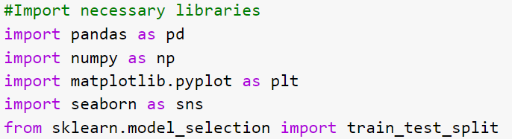
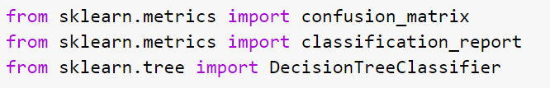
Build Model
The model building is the main step in the stress level prediction. While building the model, user use the algorithms. The steps involved are:
Import Libraries

Slide 18


Load Dataset
Data Exploration and Visualization

Slide 19
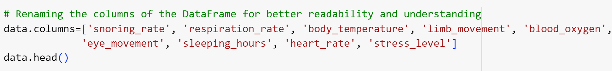



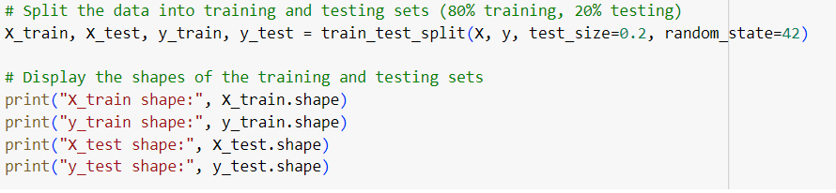
Data Cleaning and Handling Missing Values
Data Splitting

Slide 20
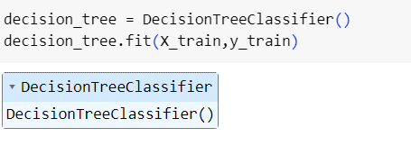
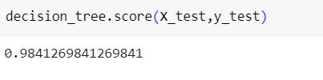
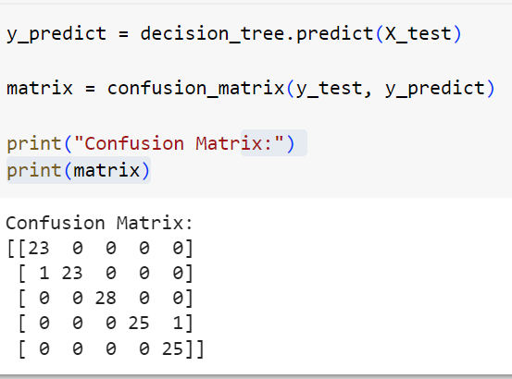
Model Training and Testing

Slide 21
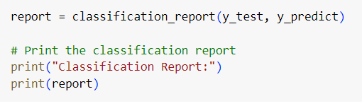
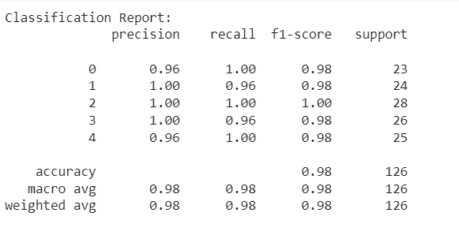

Slide 22
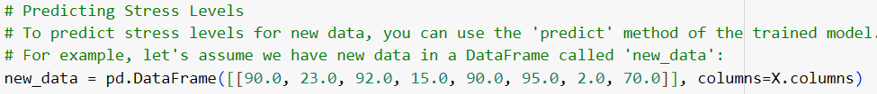
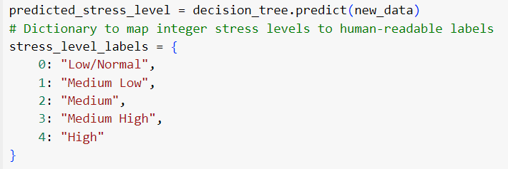
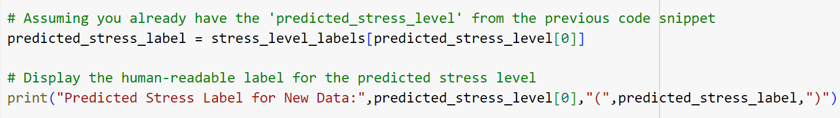
Prediction

Slide 23
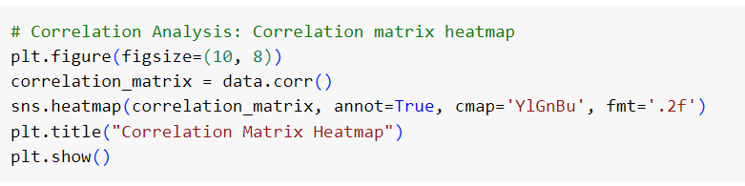
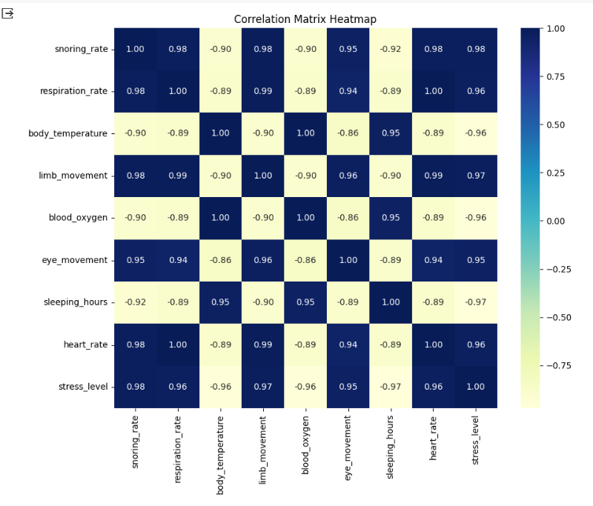
Visualise the Stress Level
Correlation Heatmap

Slide 24
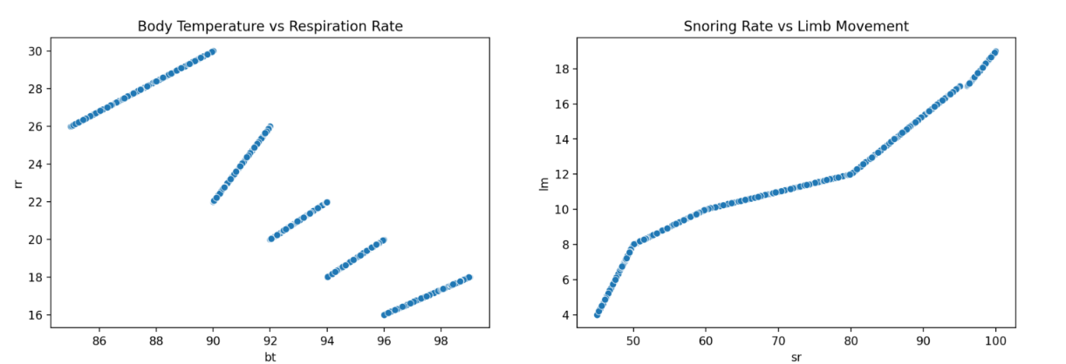
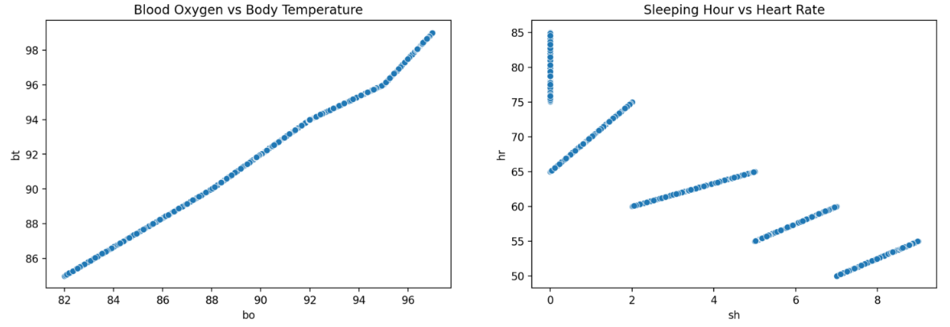
Scatter Plot

Slide 25
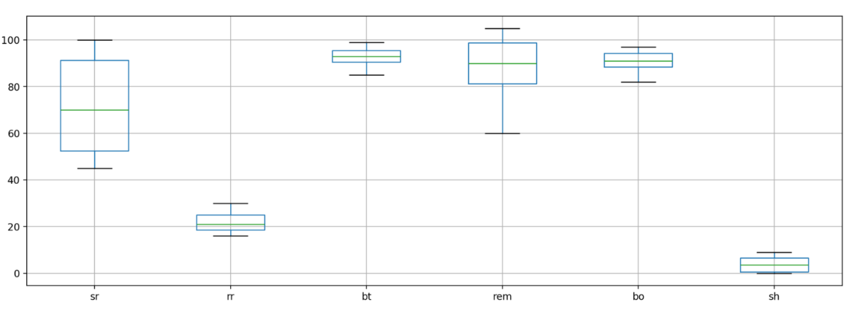
Box Plot

Slide 26
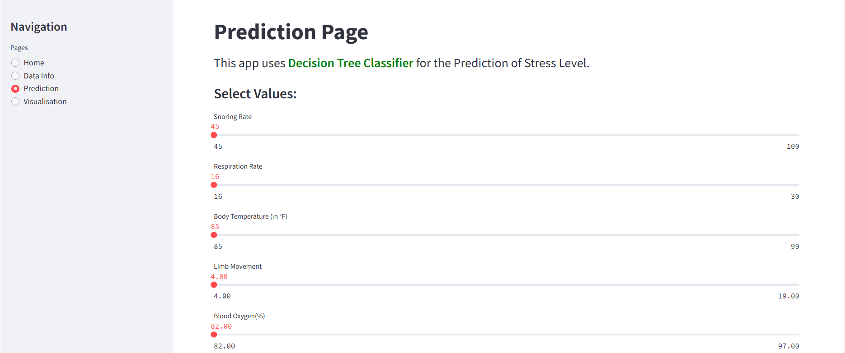
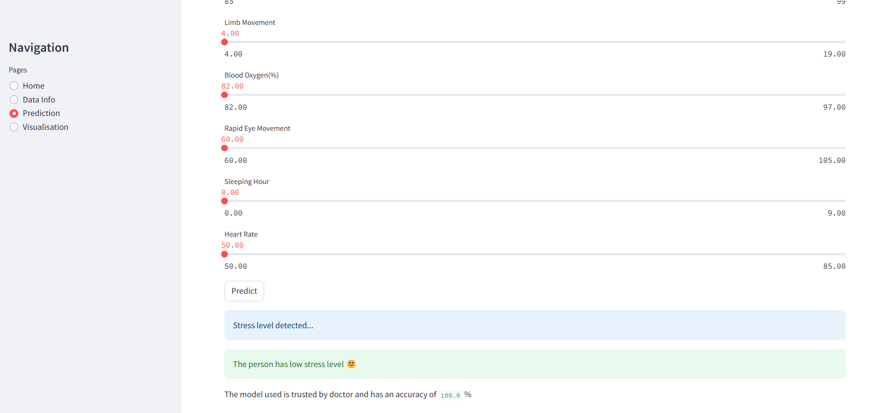
Implementation

Slide 27
Conclusion
This seminar paper concludes by presenting a thorough methodology that includes all aspects of stress level prediction, from data pre-processing to model training and evaluation. With its interpretability and predictive ability, the Decision Tree classifier proves to be a useful tool in the field of stress treatment.
The insights gathered from this study may help us identify and manage stress-related problems as we further explore the complex interactions between physiological variables and stress, which will eventually improve our quality of life and overall well-being.

Slide 28
References
[1] V.R. Archana, “Stress Detection Using Machine Learning Algorithms”, International Journal of Research in Engineering, Science and Management Volume-3, Issue-8, August-2020
[2] G. Jayawickrama, R.A.H.M. Rupasingha, “Human Stress Detection Based on Sleeping Habits Using Machine Learning Algorithms”, 2023 3rd International Conference on Advanced Research in Computing (ICARC), IEEE Conference, 2023.
[3] R. Swarna Malika, “Stress Detection Using Machine Learning Techniques”, Journal of Emerging Technologies and Innovative Research (JETIR)
[4] S.Kaviyab , S.Sarika c, “Stress Detection Based on Human Parameters Using Machine Learning Algorithms”.
[5] Md Minhazur Rahman, ASM Mohaimenul Islam, Jonayet Miah, “sleepWell:Stress Level Prediction Through Sleep Data. Are You Stressed?”

Slide 29
Thank you

